Slide 1





Created By: Group 9
2024
St.clair college
ICT
Ignite
returnpal.online

Slide 2

ICT Ignite
2024
Table of Contents
Introduction
Vision and Mission
About Data
Cleaning Process
EDA
Model development
Future Planning
returnpal.online

Slide 3
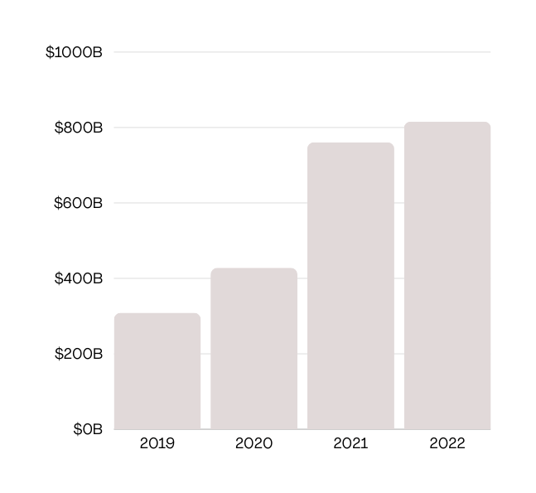
Introduction
2024
Ecommerce returns cost retailers $816 billion in 2022.
Returns generate 24 million metric tons of CO2 emissions yearly.
9.5 billion pounds of returned items end up in landfills.
Challenges include brand dissatisfaction, customer loss, and revenue impact.
Retail Return
$816 B
Return Rate
16%
carbon emissions
30%
returnpal.online

Slide 4

Vision
Vision and Mission
2024
Transforming ecommerce by minimizing returns with data analytics for a sustainable shopping experience.
Mission
Developing ML models for accurate return prediction, optimizing inventory, and boosting customer satisfaction.
returnpal.online

Slide 5


About data
2024
We obtained a detailed dataset from Reddit containing sales data from an ecommerce platform for the first quarter of 2023. With 20,000 rows and 15 columns in Excel format, it offers crucial insights into product details, pricing, category. This dataset will help us analyze consumer behavior, track product trends, and improve operational efficiency in ecommerce.
returnpal.online

Slide 6
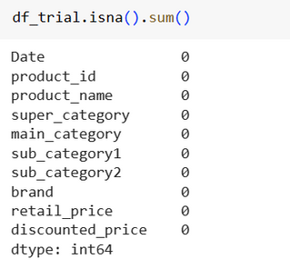
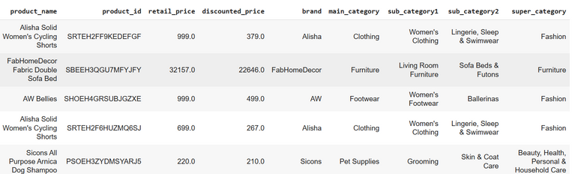
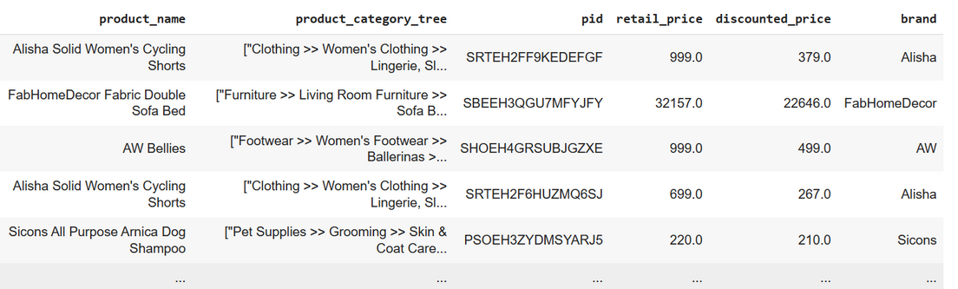
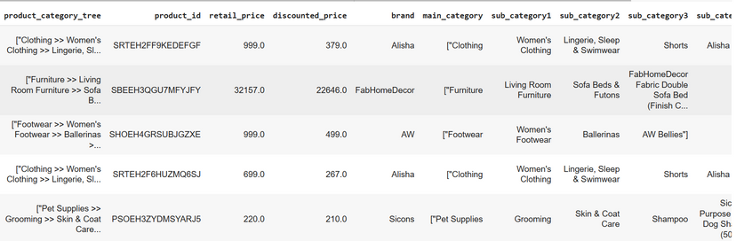
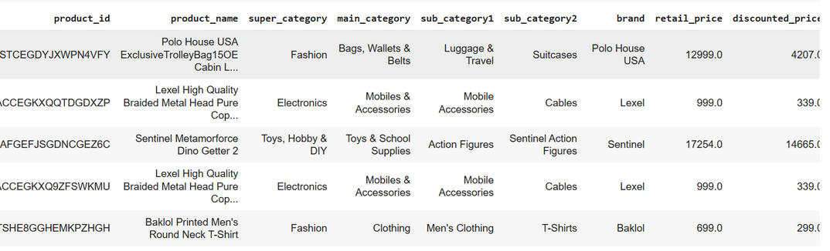

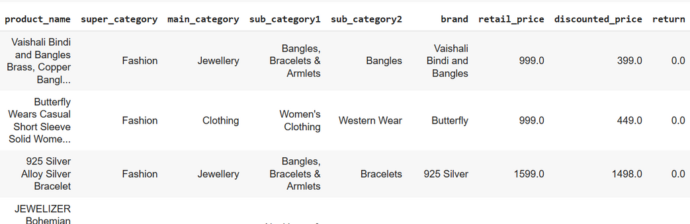
Cleaning Process
2024
1
2
3
4
5
Drop necessary columns
Split the category tree column to sub column and remove special characters
Create super category column which has total 7 categories
Fill and drop NA
Bootsrap the data and create the target column
returnpal.online

Slide 7

EDA
2024
Exploratory Data Analysis
EDA 1
EDA 2
EDA 3
EDA 4
EDA 5
returnpal.online

Slide 8


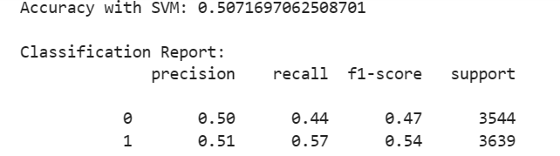
Model development
2024
Machine Learning
For machine learning we are using the SVM model. Because SVM.
Precision Accuracy shows how often a classification ML model is correct overall.
Precision shows how often an ML model is correct when predicting the target class
recall model correctly identifies positive instances (true positives)from all the actual positive samples in the dataset.
f1-score average of precision and recall
returnpal.online

Slide 9



Future Planning
2024
Incorporate the more data to imporve our model accuracy.
Attach the tableau to front end to collect the data and analysis it.
returnpal.online

Slide 10

thank you

